Slide 1

University of Diyala
Engineering College
Electrical Circuits
Underdamped Case (휶 < 흎_{ퟎ})
2
For 훼 < 휔 , 퐶 < 4퐿/푅 . The roots may be written as
0
푠 = −훼 + √−(휔² − 훼²) = −훼 + 푗휔
푑
(3.21a)
(3.21b)
1
0
푠 = −훼 − √−(휔² − 훼²) = −훼 − 푗휔
푑
2
0
where 푗 = ꢀ−ꢁ and 휔_{푑} = ꢂ휔₀^{2 − 훼2}, which is called the damping frequency. Both
휔
휔
푑
and
0
are natural frequencies because they help determine the natural response; while 휔₀ is often
called the undamped natural frequency, 휔_{푑} is called the damped natural frequency. The natural
response is
푖(푡) = 퐴 푒^{ꢃ(ꢄꢃꢅꢆ )ꢈ} + 퐴 푒^{ꢃ(ꢄꢉꢅꢆ )ꢈ} = 푒^{ꢃꢄꢈ}(퐴 푒^{ꢅꢆ ꢈ} + 퐴 푒^{ꢃꢅꢆ ꢈ})
(3.22)
(3.23)
1
ꢇ
2
ꢇ
1
ꢇ
2
ꢇ
Using Euler’s identities,
푒^{ꢅ휃} = cos ꢊ + 푗 sin ꢊ, 푒^{ꢃꢅ휃} = cos ꢊ − 푗 sin ꢊ
Trail Version
Trail Version
Trail Version
Trail Version
Trail Version
Trail Version
Trail Version
Trail Version
Trail Version
Trail Version
Trail Version
Trail Version
we get
Trail Version
푖(푡) = 푒^{ꢃꢄꢈ}[퐴 ( cos 휔 푡 + 푗 sin 휔 푡) + 퐴 ( cos 휔 푡 − 푗 sin 휔 푡)]
1
푑
푑
2
푑
푑
(3.24)
= 푒^{ꢃꢄꢈ}[(퐴 + 퐴 ) cos 휔 푡 + 푗(퐴 − 퐴 ) sin 휔 푡]
1
2
푑
1
2
푑
Replacing constants (퐴 + 퐴 ) and 푗(퐴 − 퐴 ) with constants 퐵 and 퐵 , we write
1
2
1
2
1
2
푖(푡) = 푒^{ꢃꢄꢈ}(퐵 cos 휔 푡 + 퐵 sin 휔 푡)
(3.25)
1
푑
2
푑
With the presence of sine and cosine functions, it is clear that the natural response for this
case is exponentially damped and oscillatory in nature. The response has a time constant of
ꢁ/훼 and a period of 푇 = ꢋ휋/휔_{푑}. Fig. 3.2(c) depicts a typical underdamped response. [Fig.
3.2 assumes for each case that 푖(푂) = ꢌ.].
Once the inductor current 푖(푡) is found for the RLC series circuit as shown above, other
circuit quantities such as individual element voltages can easily be found. For example, the
resistor voltage is 푣 = 푅푖, and the inductor voltage is 푣 = 퐿ꢏ푖/ꢏ푡. The inductor current
ꢍ
ꢎ
푖(푡) is selected as the key variable to be determined first in order to take advantage of Eq.
(2.lb).
We conclude this section by noting the following interesting, peculiar properties of an RLC
network:
1. The behavior of such a network is captured by the idea of damping, which is the gradual
loss of the initial stored energy, as evidenced by because of the inherent losses in them. the
continuous decrease in the amplitude of the response. The damping effect is due to the
12

Slide 2

University of Diyala
Engineering College
Electrical Circuits
presence of resistance 푅. The damping factor 훼 determines the rate at which the response is
damped. If 푅 = 0, then 훼 = 0, and we have an 퐿퐶 circuit with 1/√퐿퐶 as the undamped
natural frequency. Since 훼 < 휔ꢀ in this case, the response is not only undamped but also
oscillatory. The circuit is said to be loss‐less, because the dissipating or damping element (R)
is absent. By adjusting the value of 푅, the response may be made undamped, overdamped,
critically damped or undamped.
2. Oscillatory response is possible due to the presence of the two types of storage elements.
Having both 퐿 and 퐶 allows the flow of energy back and forth between the two. The damped
oscillation exhibited by the underdamped response is known as ringing. It stems from the
ability of the storage elements 퐿 and 퐶 to transfer energy back and forth between them.
3. Observe from Fig. 3.2 that the waveforms of the responses differ. In general, it is difficult
to tell from the waveforms the difference between the overdamped and critically damped
responses. The critically damped case is the borderline between the underdamped and
overdamped cases and it decays the fastest. With the same initial conditions, the overdamped
case has the longest settling time, because it takes the longest time to dissipate the initial
stored energy. If we desire the response that approaches the final value most rapidly without
oscillation or ringing, the critically damped critically damped circuit. circuit is the right
choice.
Trail Version
Trail Version
Trail Version
Trail Version
Trail Version
Trail Version
Trail Version
Trail Version
Trail Version
Trail Version
Trail Version
Trail Version
Trail Version
Example 3: In Fig.3.1, 푅 = 40훺, 퐿 = 4퐻, and 퐶 = 1/4 F. Calculate the characteristic roots
of the circuit. Is the natural response overdamped, under‐ damped, or critically damped?
Solution: We first calculate
훼 =
푅
=
40
= 5, 휔ꢀ =
1
=
1
= 1
2퐿 2(4)
√퐿퐶
ꢁ
1
4
4×
The roots are
푠_{ꢂ,ꢃ} = −훼 ± ꢁ훼^{ꢃ} − 휔ꢀ^{ꢃ} = −5 ± √25 − 1
or
푠_{ꢂ} = −0.101, 푠_{ꢃ} = −9.899
Since 훼 > 휔ꢀ, we conclude that the response is overdamped. This is also evident from the
fact that the roots are real and negative.
13

Slide 3

University of Diyala
Engineering College
Electrical Circuits
H.W. 3: If 푅 = 10훺, 퐿 = 5퐻, and 퐶 = 2푚퐹 in Fig.3.1, find 훼, 휔 , 푠 , and 푠 . What type
of natural response will the circuit have?
ꢀ
ꢁ
ꢂ
Answer:
Answer: 1, 10, −1 ± 푗9.95, underdamped.
Example 4: Find 푖(푡)in the circuit of Fig.1. Assume that the circuit has reached steady
state at 푡 = 0^{ꢃ}.
Solution:
For 푡 < 0, the switch is closed. The capacitor acts like an open circuit while the inductor
acts like a shunted circuit. The equivalent circuit is shown in Fig.2(a). Thus, at 푡 = 0,
푖(푂) =
10
= 1퐴,
푣(푂) = 6푖(푂) = 6푉
4 + 6
where 푖(푂) is the initial current through the inductor and 푣(푂) is the initial voltage across
the capacitor.
Trail Version
Trail Version
Trail Version
Trail Version
Trail Version
Trail Version
Trail Version
Trail Version
Trail Version
Trail Version
Trail Version
Trail Version
Trail Version
For 푡 > 0, the switch is opened and the voltage source is disconnected. The equivalent
circuit is shown in Fig.2(b), which is a source‐ free series RLC circuit. Notice that the 3훺
and 6훺 resistors, which are in series in Fig.1 when the switch is opened, have been combined
to give 푅 = 9훺 in Fig.2(b). The roots are calculated as follows:
훼 =
푅
=
9
= 9, 휔ꢀ =
1
=
1
= 10
2퐿
1
√퐿퐶
1
1
2( )
ꢄ
×
2
2 50
푠_{ꢁ,ꢂ} = −훼 ± ꢄ훼^{ꢂ} − 휔ꢀ^{ꢂ} = −9 ± √81 − 100 = −9 ± 푗4.359
Hence, the response is underdamped (훼 < 휔) ; that is,
푖(푡) = 푒^{ꢃꢅꢆ}(퐴 cos 4.359푡 + 퐴 sin 4.359푡)
(1)
(2)
ꢁ
ꢂ
We now obtain 퐴 and 퐴 using the initial conditions. At 푡 = 0,
ꢁ
ꢂ
푖(푂) = 1 = 퐴ꢁ
From Eq. (3.4),
푑ꢇ
푑ꢆ
ꢁ
|
= − [푅푖(푂) + 푣(푂)] = −2[9(1) −6] = −6퐴/푠
(3)
ꢆꢈꢀ
ꢉ
14

Slide 4
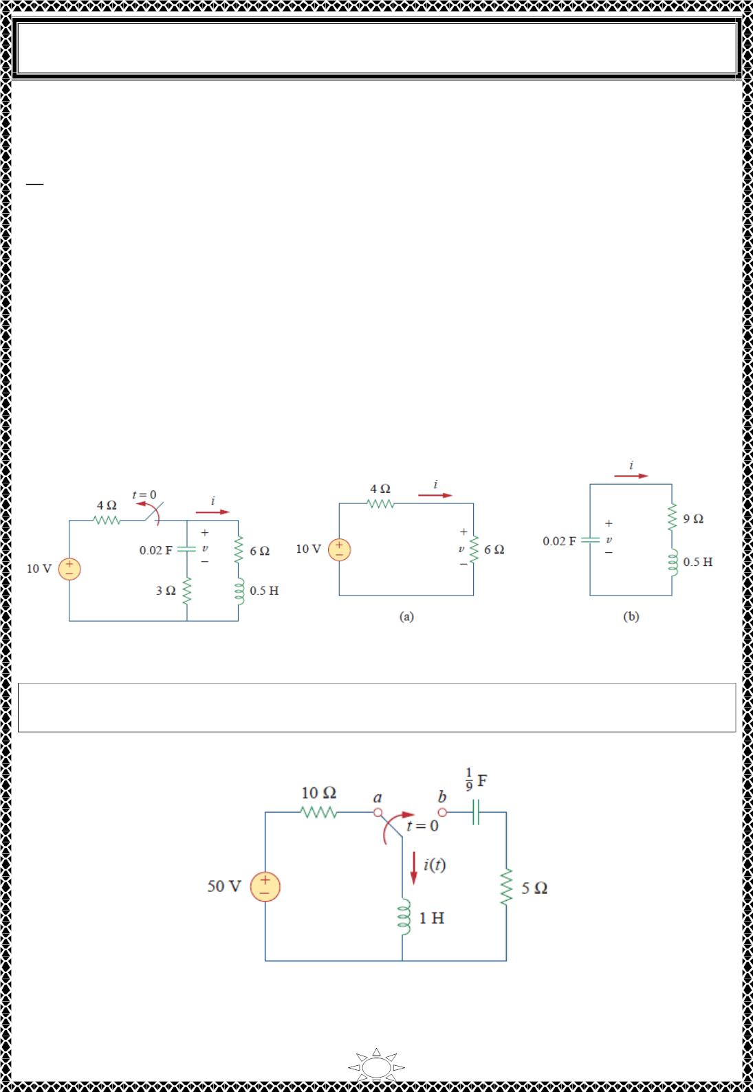
University of Diyala
Engineering College
Electrical Circuits
Note that 푣(푂) = 푉₀ = −6푉 is used, because the polarity of 푣 in Fig.2 (b) is opposite that
in Fig. 3.1. Taking the derivative of 푖(푡) in Eq. (1),
푑푖
= −9푒^{ꢀꢁꢂ}(퐴 cos 4.359푡 + 퐴 sin 4.359푡) + 푒^{ꢀꢁꢂ}(4.359)(−퐴 sin 4.359푡 + 퐴 cos 4.359푡)
푑푡
1
2
1
2
Imposing the condition in Eq. (3) at 푡 = ꢃ gives
−6 = −9(퐴 + ꢃ) + 4.359(−ꢃ + 퐴 )
1
2
But 퐴₁ = ꢄ from Eq. (2). Then
−6 = −9 + 4.359퐴 ⇒ 퐴 = ꢃ.688ꢅ
2
2
Substituting the values of 퐴 and 퐴 in Eq. (1) yields the complete solution as
1
2
푖(푡) = 푒^{ꢀꢁꢂ}( cos 4.359푡 + ꢃ.688ꢅ sin 4.359푡)퐴
Trail Version
Trail Version
Trail Version
Trail Version
Trail Version
Trail Version
Trail Version
Trail Version
Trail Version
Trail Version
Trail Version
Trail Version
Trail Version
Fig.1
Fig.2 The circuit in Fig.1: (a) for t < 0, (b) for t > 0.
ꢀ
H.W. 4: The circuit in Fig.1 has reached steady state at 푡 = ꢃ . If the make before break
switch moves to position 푏 at 푡 = ꢃ, calculate 푖(푡) for t > 0
_{Answer: 풆}^{ꢀퟐ.ퟓ풕}( ퟓ퐜퐨퐬 ퟏ. ퟔퟓퟖퟑ풕 − ퟕ. ퟓퟑퟕퟖ 퐬퐢퐧 ퟏ. ퟔퟓퟖퟑ풕)푨
‐
Fig.1
15

Slide 5

University of Diyala
Engineering College
Electrical Circuits
4) The Source-Free Parallel RLC Circuit
Parallel RLC circuits find many practical applications, notably in communications networks
and filter designs.
Consider the parallel RLC circuit shown in Fig.4.1. Assume initial inductor current I_{o} and
initial capacitor voltage V ,
1
ꢀ
o
푖(0) = 퐼_{표} = ∫ 푣(푡)푑푡
(4.1a)
(4.1b)
퐿
∞
푣(0) = 푉
ꢀ
Since the three elements are in parallel, they have the same voltage v across them. According
to passive sign convention, the current is entering each element; that is, the current through
each element is leaving the top node. Thus, applying KCL at the top node gives
ꢁ
ꢂ
ꢅ
ꢆꢁ
+ ꢄ 푣 푑푡 + 퐶 = 0
(4.2)
푅
ꢃ
−∞
ꢆꢅ
Taking the derivative with respect to 푡 and dividing by 퐶 results in
2
ꢆ ꢁ
ꢆꢅ²
+
ꢂ ꢆꢁ
ꢂ
푅ꢇ ꢆꢅ
+
푣 = 0
(4.3)
ꢃꢇ
Trail Version
Trail Version
Trail Version
Trail Version
Trail Version
Trail Version
Trail Version
Trail Version
Trail Version
Trail Version
Trail Version
Trail Version
Trail Version
We obtain the characteristic equation by replacing the first derivative by 푠 and the second
derivative by 푠^{ꢈ}. By following the same reasoning used in establishing Eqs. (3.3) through
(3.7), the characteristic equation is obtained as
ꢂ
ꢂ
푠^{ꢈ} + 푠 + = 0
(4.4)
(4.5)
푅ꢇ
ꢃꢇ
The roots of the characteristic equation are
푠_{ꢂ,ꢈ} = ꢉ
1
√
± (
1
₎ꢈ _{ꢉ}
1
ꢊꢋ퐶
ꢊꢋ퐶
퐿퐶
or
푠_{ꢂ,ꢈ} = ꢉ훼 ± ꢌ훼^{ꢈ} ꢉ 휔ꢀ^{ꢈ}
(4.6)
(4.7)
where
훼 =
1
,
휔ꢀ =
1
ꢊꢋ퐶
ꢍ퐿퐶
The names of these terms remain the same as in the preceding section, as they play the same
role in the solution. Again, there are three possible solutions, depending on whether 훼 >
휔 , 훼 = 휔 , or 훼 < 휔 . Let us consider these cases separately.
ꢀ
ꢀ
ꢀ
16

Slide 6
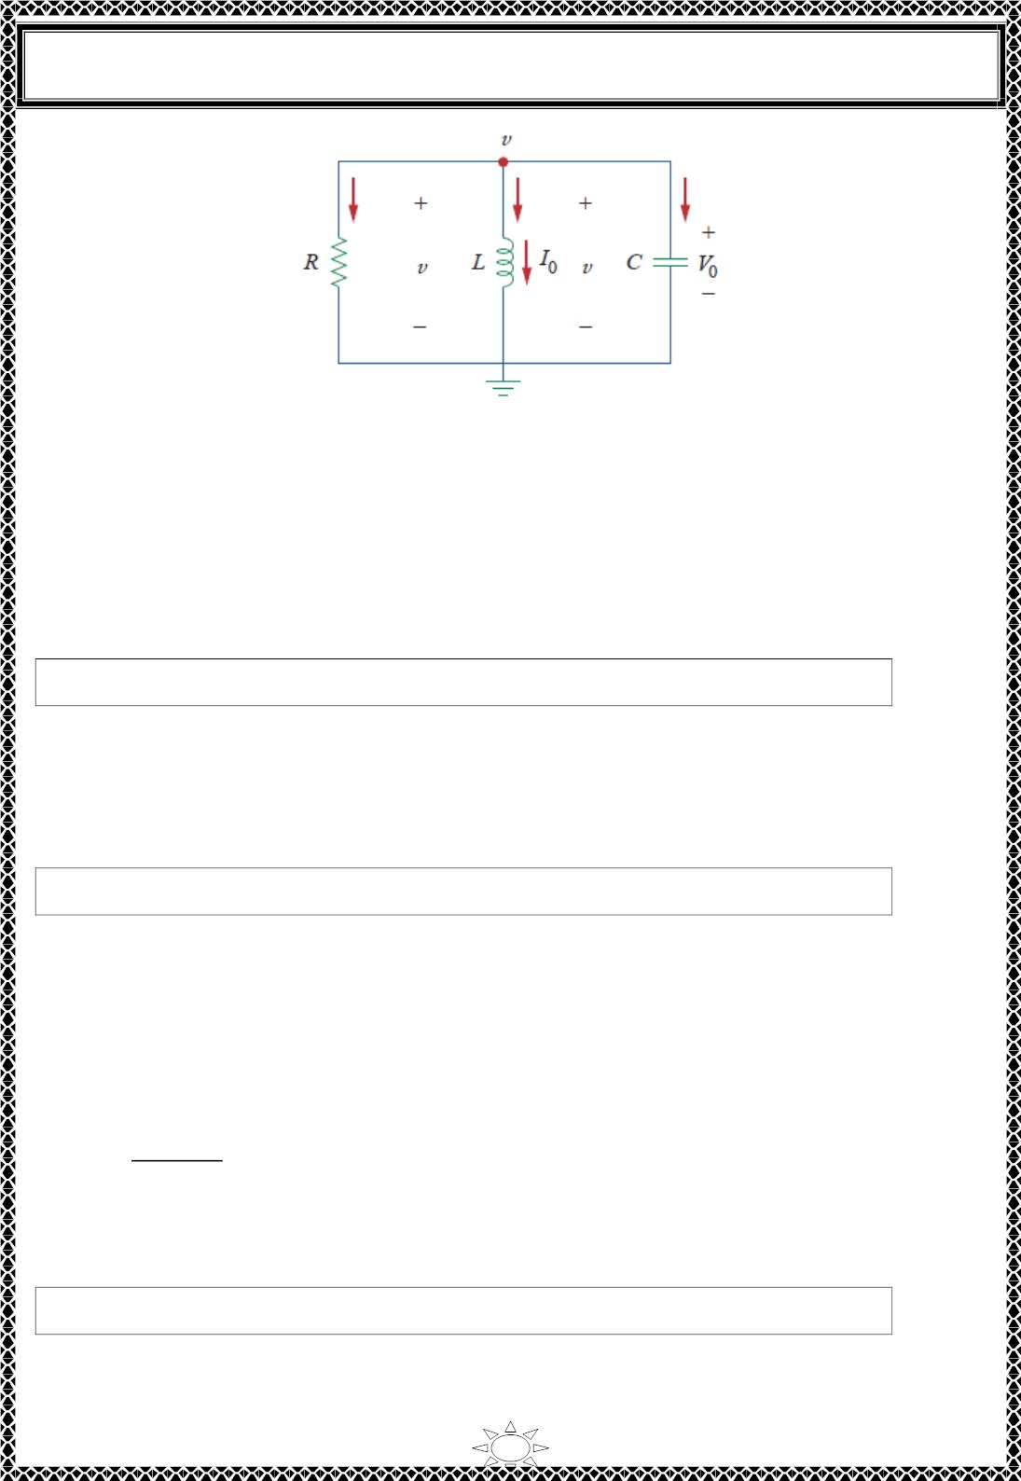
University of Diyala
Engineering College
Electrical Circuits
Fig.4.1 A source-free parallel RLC circuit.
Overdamped Case (휶 > 흎_{ퟎ})
²퐶
From Eq. (4.7), 훼 > 휔 when 퐿 > 4푅 . The roots of the characteristic equation are real
0
and negative. The response is
푣(푡) = 퐴 푒^{푠 ꢁ} + 퐴 푒^{푠 ꢁ}
Trail Version
Trail Version
Trail Version
Trail Version
Trail Version
Trail Version
Trail Version
Trail Version
Trail Version
Trail Version
Trail Version
Trail Version
Trail Version
1
ꢀ
2
ꢂ
(4.8)
Critically Damped Case (휶 = 흎_{ퟎ})
For 훼 = 휔 , 퐿 = 4푅²퐶. The roots are real and equal so that the response is
0
푣(푡) = (퐴 + 퐴 푡)푒−ꢃꢁ
(4.9)
1
2
Underdamped Case (휶 < 흎_{ퟎ})
²퐶
When 훼 < 휔 , 퐿 < 4푅 . In this case the roots are complex and may be expressed as
0
^{ꢄ}_{1,2} = ꢅ훼 ± 푗휔_{푑}
(4.10)
where
휔 = √휔² ꢅ 훼²
(4.11)
(4.12)
푑
0
The response is
푣(푡) = 푒^{−ꢃꢁ}(퐴 cos 휔 푡 + 퐴 sin 휔 푡)
1
푑
2
푑
17

Slide 7

University of Diyala
Engineering College
Electrical Circuits
The constants 퐴 and 퐴 in each case can be determined ffom the initial conditions. We
1
2
need 푣(푂) and 푑푣(푂)/푑푡. The first term is known from Eq. (4.1b). We find the second
term by combining Eqs. (4.1) and (4.2), as
푉
푑푣(ꢀ)
푑푡
0
+ 퐼₀ + 퐶
= ꢀ
푅
or
푑푣(ꢀ)
푑푡
= −
(푉 + 푅퐼 )
0 0
(4.13)
푅퐶
The voltage waveforms are similar to those shown in Fig. 3.2 and will depend on whether
the circuit is overdamped, underdamped, or critically damped.
Having found the capacitor voltage 푣(푡) for the parallel RLC circuit as shown above, we
can readily obtain other circuit quantities such as individual element currents. For example,
the resistor current is 푖 = 푣/푅 and the capacitor voltage is 푣 = 퐶푑푣/푑푡. We have selected
ꢁ
ꢂ
the capacitor voltage 푣(푡) as the key variable to be determined first in order to take
advantage of Eq. (2.la). Notice that we first found the inductor current 푖(푡) for the RLC
series circuit, whereas we first found the capacitor voltage 푣(푡) for the parallel RLC circuit.
Trail Version
Trail Version
Trail Version
Trail Version
Trail Version
Trail Version
Trail Version
Trail Version
Trail Version
Trail Version
Trail Version
Trail Version
Trail Version
Example 5: In the parallel circuit of Fig. 4.1, find 푣(푡) for 푡 > ꢀ, assuming 푣(푂) = 5푉,
푖(푂) = ꢀ, 퐿 = ꢃ퐻, and 퐶 = ꢃꢀ푚퐹. Consider these cases: 푅 = ꢃ.9ꢄ3훺, 푅 = 5훺, and 푅 =
6.ꢄ5훺.
Solution:
CASE 1 If 푅 = ꢃ.9ꢄ3훺,
훼 =
ꢃ
=
ꢃ
= ꢄ6
ꢄ푅퐶 ꢄ×ꢃ.9ꢄ3×ꢃꢀ×ꢃꢀ^{ꢅꢆ}
휔₀ =
ꢃ
=
ꢃ
= ꢃꢀ
√퐿퐶 √ꢃ×ꢃꢀ×ꢃꢀ^{ꢅꢆ}
Since 훼 > 휔₀ in this case, the response is overdamped. The roots of the characteristic
equation are
푠_{1,2} = −훼 ± ꢇ훼² − 휔₀² = −ꢄ, −5ꢀ
and the corresponding response is
18

Slide 8

University of Diyala
Engineering College
Electrical Circuits
푣(푡) = 퐴 푒^{−2ꢀ} + 퐴 푒−50ꢀ
(1)
(2)
1
2
We now apply the initial conditions to get 퐴 and 퐴 .
1
2
푣(푂) = ꢁ = 퐴₁ + 퐴₂
푑푣(ꢂ)
푑푡
= ꢃ
푣(ꢂ) + 푅푖(ꢂ)
= ꢃ
ꢁ + ꢂ
ꢄ.9ꢅ3×ꢄꢂ×ꢄꢂ−ꢆ
= ꢃꢅ6ꢂ
푅퐶
But differentiating Eq. (1),
푑푣
= ꢃꢅ퐴 푒^{−2ꢀ} ꢃ ꢁꢂ퐴 푒−50ꢀ
푑푡
1
2
At 푡 = ꢂ,
ꢃꢅ6ꢂ = ꢃꢅ퐴₁ ꢃ ꢁꢂ퐴₂
(3)
From Eqs. (2) and (3), we obtain 퐴 = ꢃꢂ.ꢅꢂ83 and 퐴 = ꢁ.ꢅꢂ8. Substituting 퐴 and 퐴
in Eq. (1) yields
1
2
1
2
Trail Version
Trail Version
Trail Version
Trail Version
Trail Version
Trail Version
Trail Version
Trail Version
Trail Version
Trail Version
Trail Version
Trail Version
Trail Version
푣(푡) = ꢃꢂ.ꢅꢂ83푒^{−2ꢀ} + ꢁ.ꢅꢂ8푒−50ꢀ
(4)
CASE 2 When 푅 = ꢁ훺,
훼 =
ꢄ
=
ꢄ
= ꢄꢂ
ꢅ푅퐶 ꢅ×ꢁ×ꢄꢂ×ꢄꢂ−ꢆ
while 휔 = ꢄꢂ remains the same. Since 훼 = 휔 = ꢄꢂ, the response is critically damped.
0
0
Hence, 푠 = 푠 = ꢃꢄꢂ, and
1
2
푣(푡) = (퐴 + 퐴 푡)푒−10ꢀ
(5)
(6)
1
2
To get 퐴 and 퐴 , we apply the initial conditions
1
2
푢(ꢂ) = ꢁ = 퐴₁
푑푣(ꢂ)
푑푡
= ꢃ
푣(ꢂ) + 푅푖(ꢂ)
푅퐶
= ꢃ
ꢁ + ꢂ
ꢁ×ꢄꢂ×ꢄꢂ−ꢆ
= ꢃꢄꢂꢂ
But differentiating Eq. (5),
푑푣
= (ꢃꢄꢂ퐴 ꢃ ꢄꢂ퐴 푡 + 퐴 )푒−10ꢀ
푑푡
1
2
2
19

Slide 9

University of Diyala
Engineering College
Electrical Circuits
At 푡 = 0,
−100 = −10퐴ꢀ + 퐴₂
(7)
(8)
From Eqs. (6) and (7), 퐴 = 5 and 퐴 = −50. Thus,
ꢀ
2
푣(푡) = (5 − 50푡)푒^{ꢁꢀꢂꢃ}푉
CASE 3 When 푅 = 6.ꢄ5훺,
훼 =
1
=
1
= 8
ꢄ푅퐶 ꢄ×6.ꢄ5×10×10^{ꢁ3}
while 휔 = 10 remains the same. As 훼 < 휔 in this case, the response is underdamped. The
ꢂ
ꢂ
roots of the characteristic equation are
푠_{ꢀ,2} = −훼 ± √훼² − 휔_{ꢂ}² = −8 ± 푗6
Trail Version
Trail Version
Trail Version
Trail Version
Trail Version
Trail Version
Trail Version
Trail Version
Trail Version
Trail Version
Trail Version
Trail Version
Trail Version
Hence,
푣(푡) = (퐴 cos 6푡 + 퐴 sin 6푡)푒^{ꢁꢅꢃ}
(9)
ꢀ
2
We now obtain 퐴 and 퐴 , as
ꢀ
2
푣(푂) = 5 = 퐴ꢀ
(10)
푑푣(0)
푑푡
= −
푣(0) + 푅푖(0)
푅퐶
= −
5 + 0
6.ꢄ5×10×10^{ꢁ3}
= −80
But differentiating Eq. (9),
ꢆꢇ
= (−8퐴 cos 6푡 − 8퐴 sin 6푡 − 6퐴 sin 6푡 + 6퐴 cos 6푡)푒^{ꢁꢅꢃ}
ꢆꢃ
ꢀ
2
ꢀ
2
At 푡 = 0,
−80 = −8퐴ꢀ + 6퐴₂
(11)
(12)
From Eqs. (10) and (11), 퐴 = 5 and 퐴 = −6.667. Thus,
ꢀ
2
푣(푡) = (5 cos 6푡 − 6.667 sin 6푡)푒^{ꢁꢅꢃ}
Notice that by increasing the value of 푅, the degree of damping decreases and the
responses differ. Fig.1 plots the three cases.
20

Slide 10
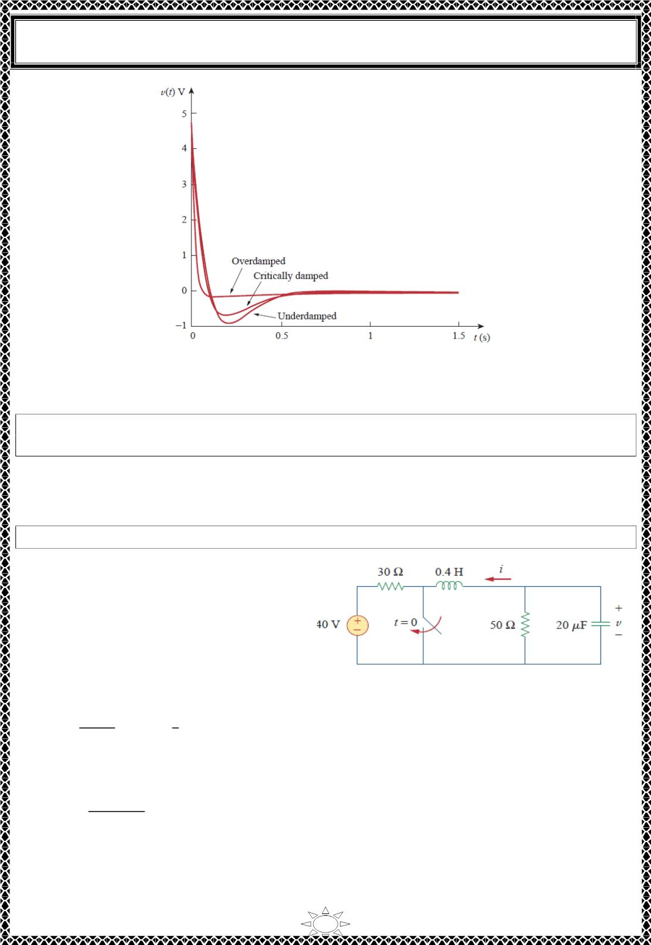
University of Diyala
Engineering College
Electrical Circuits
Fig.1: responses for three degrees of damping.
H.W. 5: In Fig.4.1, let 푅 = 2훺, 퐿 = 0.4퐻, 퐶 = 25푚퐹, 푣(푂) = 0, 푖(푂) = 10푚퐴. Find
푣(푡) for 푡 > 0.
Answer: −ퟒퟎퟎ풕풆^{ꢀퟏퟎ풕풗(풕)풎푽.}
Trail Version
Trail Version
Trail Version
Trail Version
Trail Version
Trail Version
Trail Version
Trail Version
Trail Version
Trail Version
Trail Version
Trail Version
Trail Version
Example 6:Find 푣(푡) for 푡 > 0 in the RLC circuit of Fig.1.
Solution:
When 푡 < 0, the switch is open; the
inductor acts like a short circuit while the
capacitor behaves like an open circuit. The
initial voltage across the capacitor is the
same as the voltage across the 50 − 훺
resistor; that is,
Fig.1.
푣(푂) =
ꢁꢂ
ꢁ
3ꢂ+ꢁꢂ
(40) = ×40 = 25푉
(1)
8
The initial current through the inductor is
푖(0) = −
40
= −0.5퐴
ꢃ0 ꢄ 50
21

